Slide 1
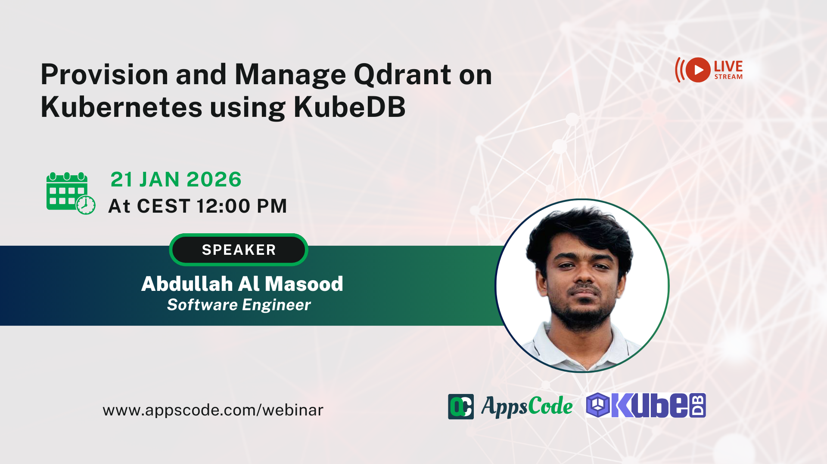

Slide 2



Table of Contents
Slide
‹#›
What is Qdrant
Key Features of Qdrant
Provision Qdrant using KubeDB
Live Demo
Q&A Session
hello@appscode.com
@KubeDB
kubedb.com

Slide 3

Qdrant Key Features
Slide
‹#›
Enables fast vector similarity search
Distributed, Highly Available, and Scalable
Rust-based for performance and safety
HNSW indexing ensures low-latency retrieval
Advanced quantization reduces memory usage
Wide integrations with embeddings frameworks
Rich payload filtering and querying
Efficient sparse vector support
hello@appscode.com
@KubeDB
kubedb.com

Slide 4
Qdrant Use Cases
AI agents and autonomous systems
‹#›
Slide
Advanced semantic and multimodal search
Personalized recommendation systems
Retrieval-Augmented Generation (RAG)
Data analysis and anomaly detection
AI agents and autonomous systems
hello@appscode.com
@KubeDB
kubedb.com

Slide 5
What KubeDB offers for Qdrant
Slide
‹#›
Simplify provisioning Qdrant on Kubernetes
Multiple mode support: Distributed mode & Standalone mode
Continuously running, customizable health checker
Custom configuration support
Secure authentication using Kubernetes Secrets
Ensure TLS secured connectivity among replicas and external clients
Support for production ready versions: 1.16.2, 1.15.4
hello@appscode.com
@KubeDB
kubedb.com

Slide 6
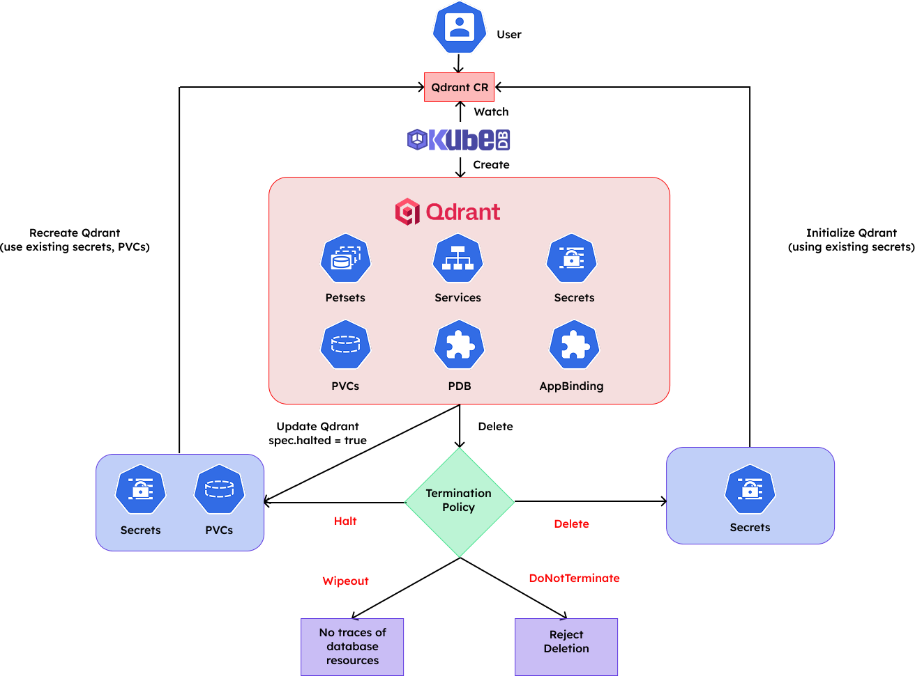
Provision Qdrant Using KubeDB
Slide
‹#›
hello@appscode.com
@KubeDB
kubedb.com

Slide 7
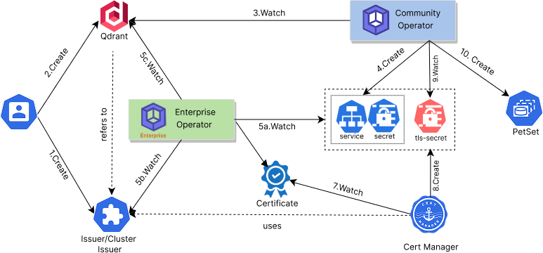
TLS Configuration Using KubeDB
Slide
‹#›
hello@appscode.com
@KubeDB
kubedb.com

Slide 8

Slide
‹#›
Live Demo
hello@appscode.com
@KubeDB
kubedb.com

Slide 9
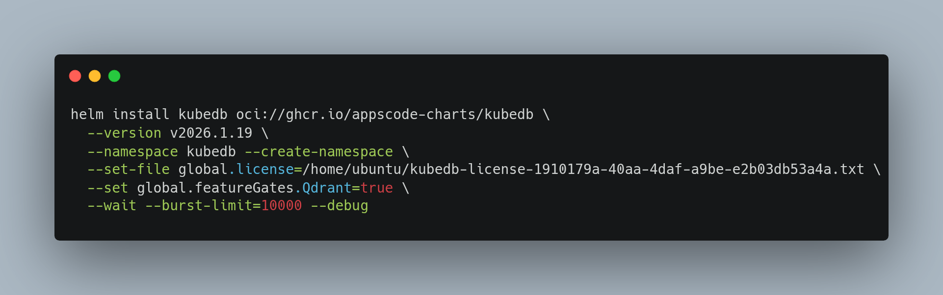
Slide
‹#›
KubeDB
Installation
hello@appscode.com
@KubeDB
kubedb.com

Slide 10
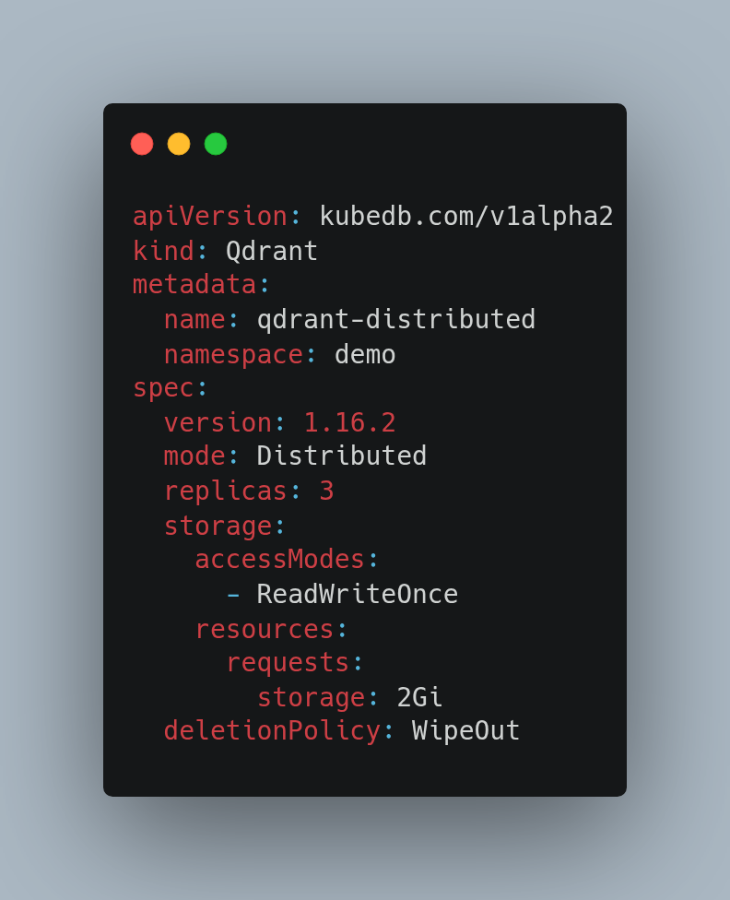
Provisioning a Distributed Qdrant Instance
Slide
‹#›
hello@appscode.com
@KubeDB
kubedb.com

Slide 11
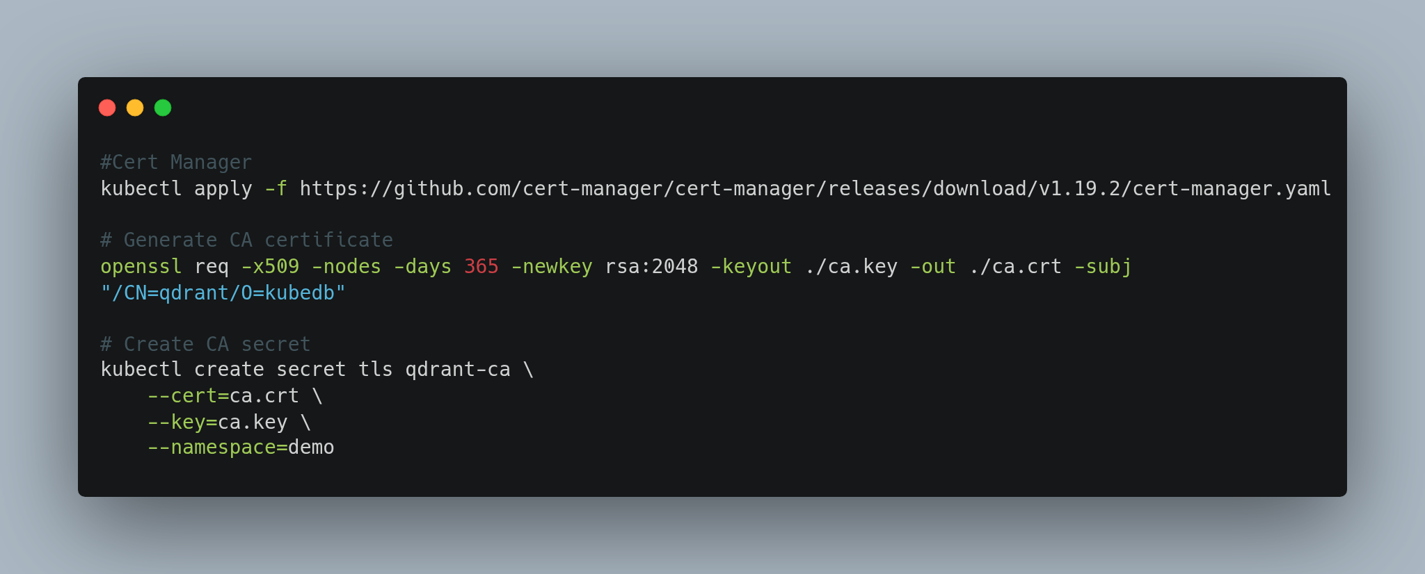
TLS Certification and Secret Generation
Slide
‹#›
hello@appscode.com
@KubeDB
kubedb.com

Slide 12
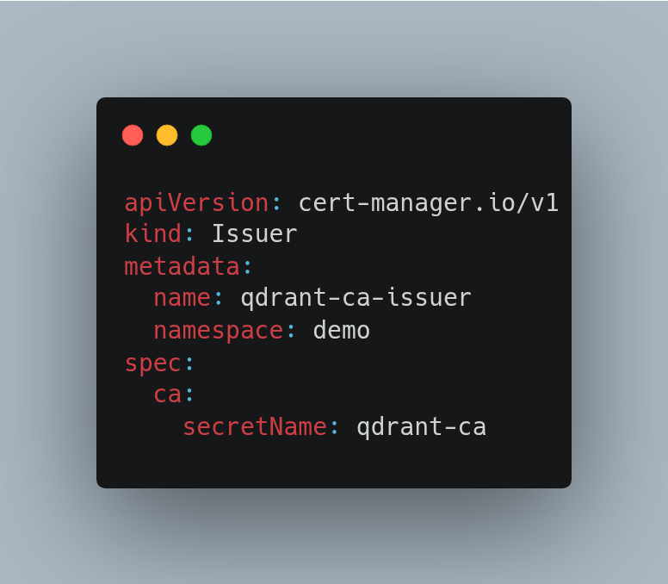
Sample YAML
Slide
‹#›
hello@appscode.com
@KubeDB
kubedb.com

Slide 13
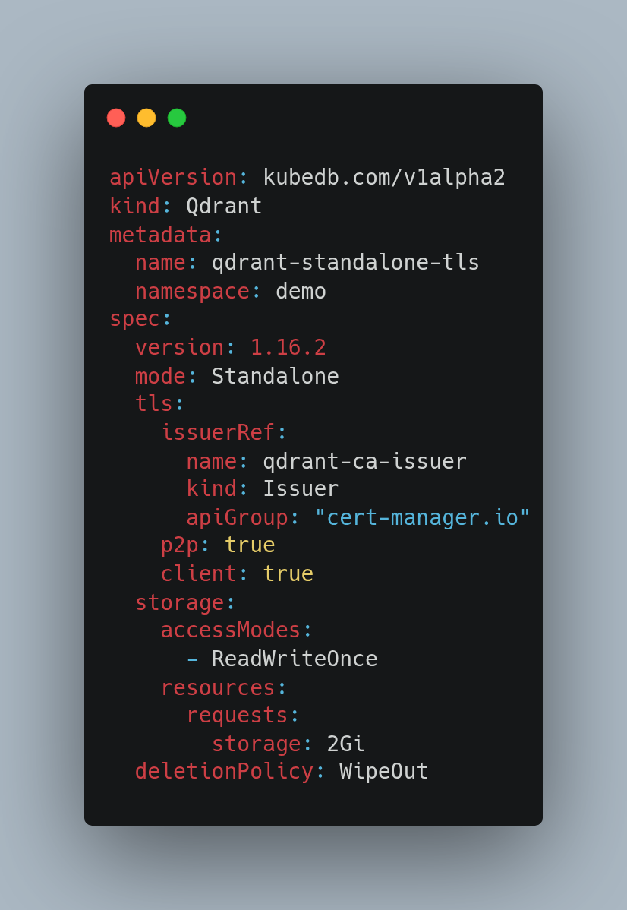
Sample YAML
Slide
‹#›
hello@appscode.com
@KubeDB
kubedb.com

Slide 14
Upcoming Features
Slide
‹#›
Monitoring
Backup
Ops Request
New Versions
hello@appscode.com
@KubeDB
kubedb.com

Slide 15

Slide
‹#›
hello@appscode.com
@KubeDB
kubedb.com

Slide 16



Slide
‹#›
hello@appscode.com
@KubeDB
Thanks!
kubedb.com
github.com/kubedb

